Slide 1

Financial Services Hack to Learn Insurance Claims Automation
Cindy Mar – Director, CSU
Vipul Shah – Director, Specialist
Sivanandhan Paramasivam – Data & AI Specialist, Insurance
Kapil Dhanger – Cloud Solution Architect – Data & AI
Pratima Valavala - Cloud Solution Architect – Data & AI
Ashish Talati – Cloud Solution Architect – Data & AI

Slide 2
Agenda
Eastern Time Zone | Wednesday February 15th
11:30AM-12:00PM EST | Welcome & Opening Remark – Specialist
12:00PM-12:30PM EST | Industry Speakers & Perspectives - Jonathan Silverman​
12:30PM-3:15PM EST | Hack-To-Learn Day 1 – Team Breakout
3:15PM-3:30PM EST | Closing - Specialist
Eastern Time Zone | Thursday February 16th
11:30AM-11:40AM EST | Welcome Back and Day 1 Recap
11:40AM-2:10PM EST | Hack-To-Learn Day 2 - Team Breakout
2:10PM-2:30PM EST | Closing & Next Steps – Cindy Mar

Slide 3

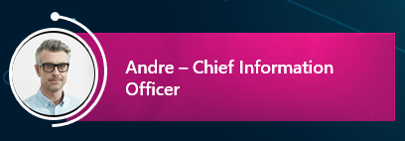
AI-Powered Insurance Claims Automation
Chief information officer Andre is responsible for making sure that all Customer data is ingested properly and is available for any other application or organization.
A large portion of information submitted by customers comes in either handwritten or scanned forms. Woodgrove spends manual labor hours to scrape and digitize the data.
The manual process has slowed down the pace of business and adds significant cost. To enhance the customer experience and cut expenses Andre is looking to use Artificial intelligence and other Azure services to automate this process.

Slide 4










AI-Powered Insurance Claims Automation - Architecture
User Input
Channels
Azure Bot + Cognitive Services
Analytics
Power BI
Text
ID Model
Speech
Storage
Logic app
Invoice Model
Data store
Business Process
Image
NLP
Insurance Model

Slide 5





Many Hats of a data driven Organization
Responsible for business needs and outcomes
Responsible for training AI models
Responsible for Process automation
Responsible for designing user interfaces
Responsible for end to end testing
Business Owner
Data Scientist
Automation/RPA Engineer
User interface
Dev
End to End Acceptance

Slide 6
AI-Powered Insurance Claims Automation - Architecture
User Input
Channels
Azure Bot + Cognitive Services
Analytics
Power BI
RPA Engg
Text
ID Model
Speech
Storage
Logic app
Invoice Model
Data store
Business Process
Image
NLP
Insurance Model
User interface
Dev
Data Scientist
Business Owner

Slide 7
Day 1
Orientation and context and tech setup 30 mins
Background
Environment
Needed assets
Hack format
Hack & learn 1 Business owner 10 min
Business problem summary
Hack & learn 2 Data Scientist 90 min
Forms Recognizer intro and demo
Forms recognizer prebuild DL model test
Label and train a new model for Insurance
Custom vision intro and demo
Custom vision training and testing

Slide 8
Day 2
Hack and Learn 3 – Automation/Data Engg 90 mins
Introduction to logic apps
Introduction to cosmos db
Plug in models
Test using upload to storage account
Introduction to Cognitive search
Test cognitive search
Hack and learn 4 – User interface Dev 30 min
Introduction to Cognitive Search
Web interface
Hack and learn 5 – End to end test 30 mins

Slide 9
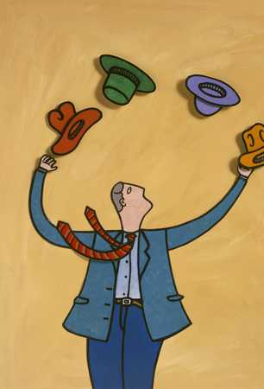
Event format
All participant will wear a dawn different personas and complete the subset of challenges.
This hack to learn has 5 challenges corresponding to 5 different personas.
Each challenge has detailed objectives – to complete a challenge
Complete the acceptance criteria
Post relevant details on the channel chat
For each challenge, the coach will give you a technology overview and walkthrough.
You would also be provided with detailed instructions if needed.
If you are stuck or have immediate questions raise your hand and one of the coaches will assist you.

Slide 10
Hat 1
Objectives
Understand the business context of the challenge
Acceptance criteria
Business owner write a short summary of project goals for the IT team.
Define high level expectations of the project
Business Owner
Est. time 15 mins

Slide 11

Before you throw your hat
Post the output artifacts on the group chat
Post any open questions on the chat

Slide 12
Introduction to custom vision

Slide 13
Vision Services – Computer Vision
OCR
Image Analysis
Extract printed or handwritten text from images, such as photos of street signs and products, as well as from documents—invoices, bills, financial reports, articles, and mor
REST
Extract a wide variety of visual features from your images. For example, it can determine whether an image contains adult content, find specific brands or objects, or find human faces
SDK + REST
Notes:
Computer Vision documentation - Quickstarts, Tutorials, API Reference - Azure Cognitive Services | Microsoft Docs
https://docs.microsoft.com/en-us/azure/cognitive-services/computer-vision/
What is Optical character recognition? - Azure Cognitive Services | Microsoft Docs
https://docs.microsoft.com/en-us/azure/cognitive-services/computer-vision/overview-ocr
What is Image Analysis? - Azure Cognitive Services | Microsoft Docs
https://docs.microsoft.com/en-us/azure/cognitive-services/computer-vision/overview-image-analysis

Slide 14
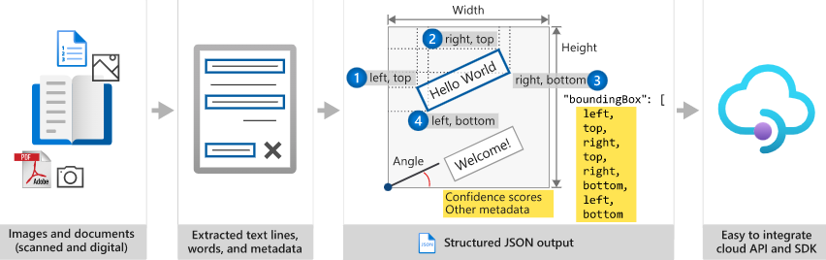
Vision Services – Computer Vision – Read API
Notes:
What is Optical character recognition? - Azure Cognitive Services | Microsoft Docs
https://docs.microsoft.com/en-us/azure/cognitive-services/computer-vision/overview-ocr
The Computer Vision Read API is Azure's latest OCR technology (learn what's new) that extracts printed text (in several languages), handwritten text (in several languages), digits, and currency symbols from images and multi-page PDF documents. It's optimized to extract text from text-heavy images and multi-page PDF documents with mixed languages. It supports detecting both printed and handwritten text in the same image or document.

Slide 15
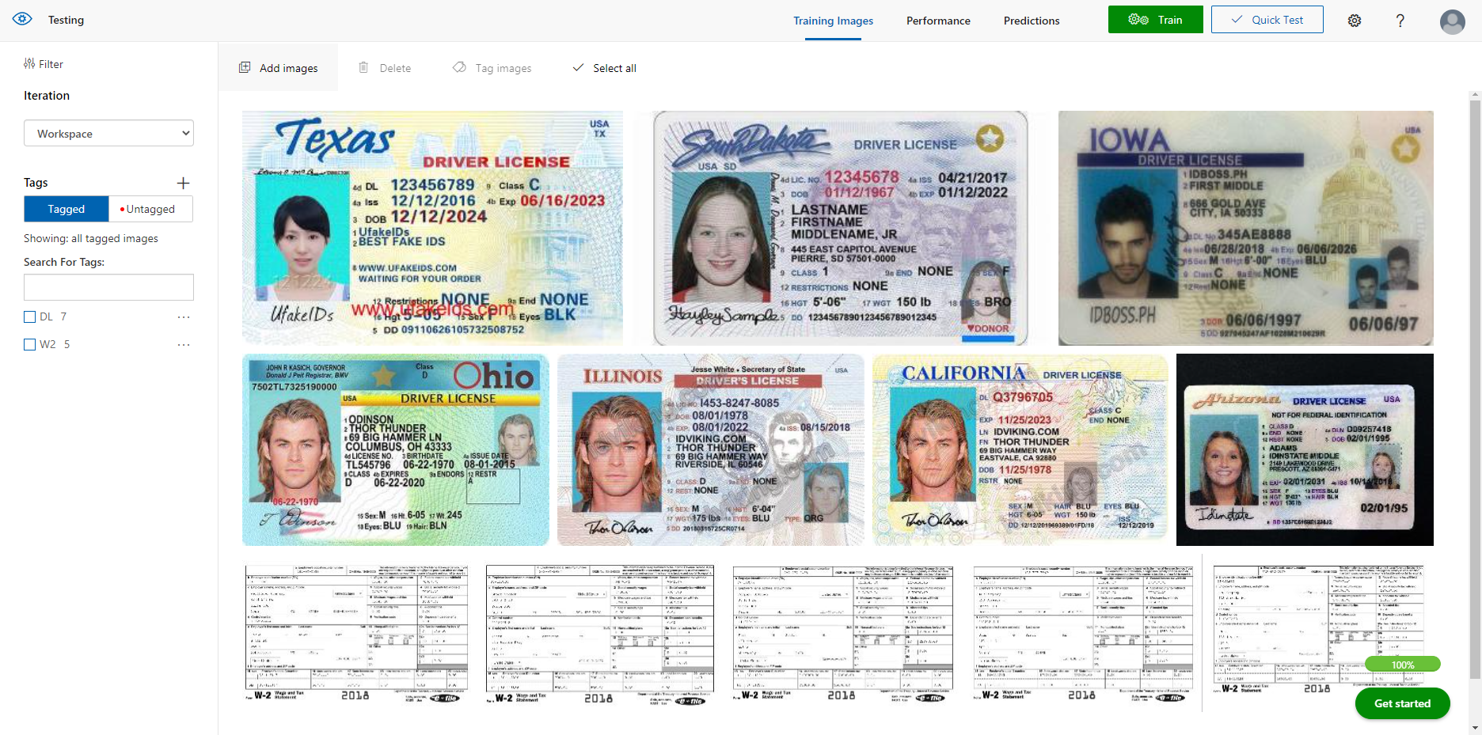
Vision Services – Custom Vision
http://www.customvision.ai/
Custom Models For:
Image Classification
Object Detection
Notes:
Custom Vision documentation - Quickstarts, Tutorials, API Reference - Azure Cognitive Services | Microsoft Docs
https://docs.microsoft.com/en-us/azure/cognitive-services/custom-vision-service/
Azure Custom Vision is an image recognition service that lets you build, deploy, and improve your own image identifier models. An image identifier applies labels (which represent classifications or objects) to images, according to their detected visual characteristics. Unlike the Computer Vision service, Custom Vision allows you to specify your own labels and train custom models to detect them.
We will walk through this in the demo section

Slide 16
Hat 2
Objectives
Train custom vision
Acceptance criteria
Custom Model
Train Forms recognizer model
Understanding of out of the box AI model
Data Scientist
Est. time 90 mins

Slide 17
Introduction Forms recognizer

Slide 18

Azure Form Recognizer Overview
Cloud-based service that uses machine-learning models to extract and analyze form fields, text, and tables from your documents.
It easily identifies, extracts, and analyzes the following document data:
Table structure and content
Form elements and field values
Typed and handwritten alphanumeric text
Relationships between elements
Key/value pairs
Element location with bounding box coordinates

Slide 19
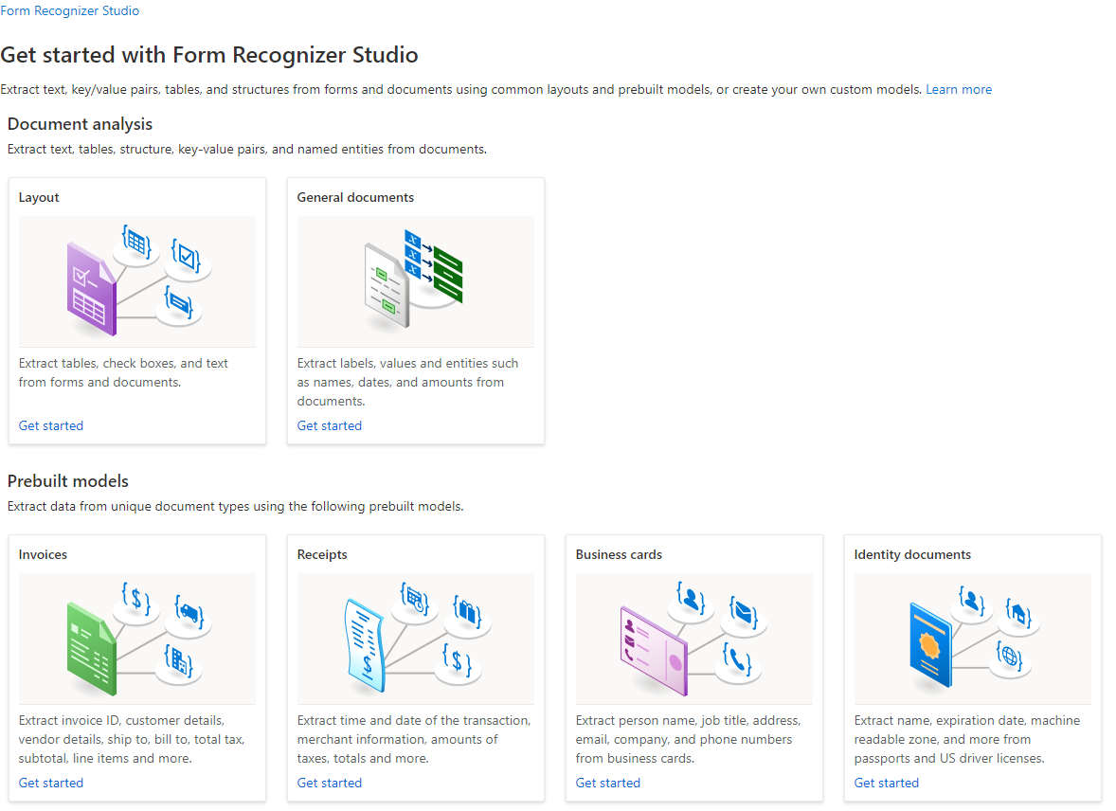
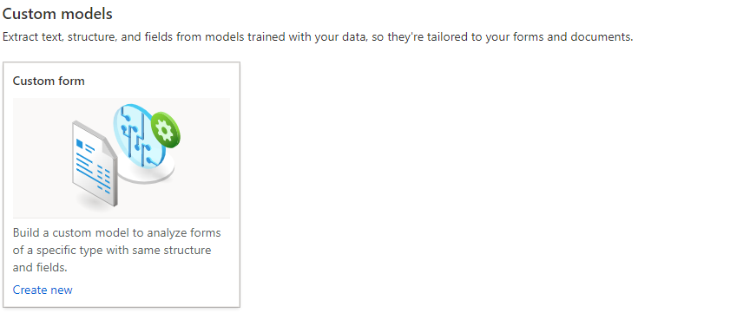
Azure Applied AI Services – Azure Form Recognizer
Key Services
Layout
General
Prebuilt
Custom
https://formrecognizer.appliedai.azure.com/studio
Notes:
Azure Form Recognizer provides several pre-built models as well as tooling to build your own models. You can use the prebuilt Invoice, Business Cards, Identity and Receipts models to automatically extract key value pairs.

Slide 20
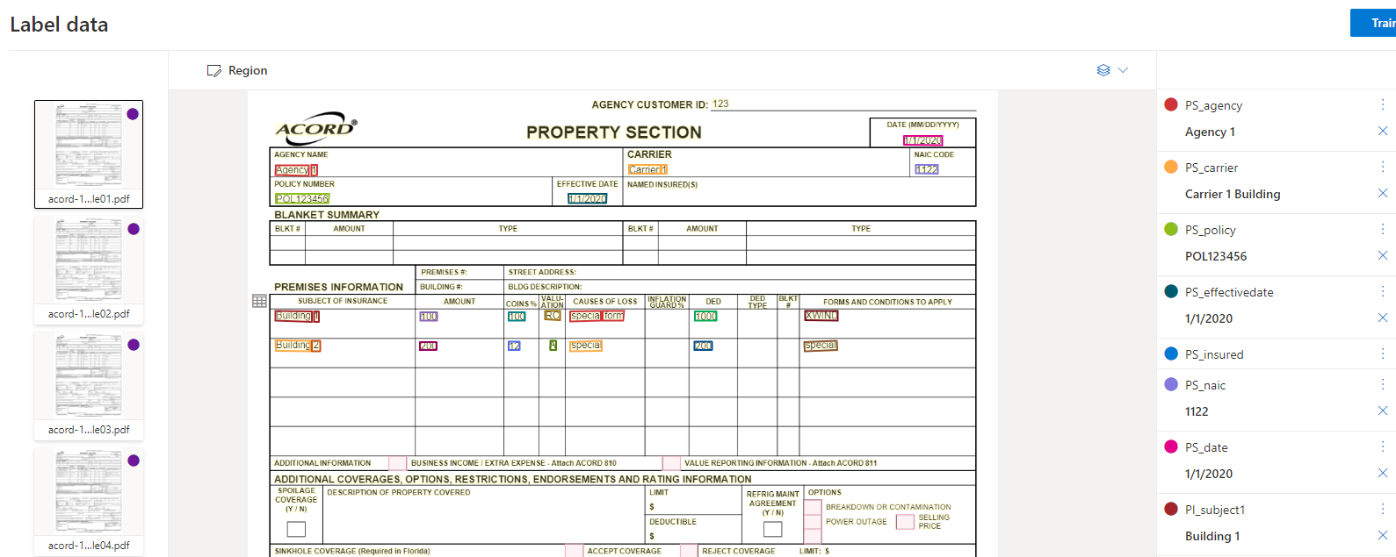
Azure Form Recognizer – Document Labelling
Notes:
The document labelling tool uses the Analyze API to OCR and extract content from the document and then displays it in an easy to use labelling form. We will demonstrate this in the Demo.

Slide 21
Introduction to Logic App

Slide 22






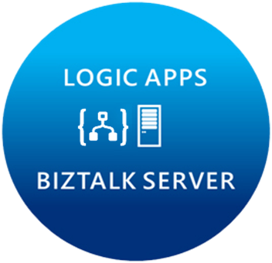
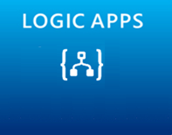















Microsoft’s Cloud Integration Platform
LOGIC APPS
BIZTALK SERVER
About 39% of developers are focused on building cloud based Application integration
API MANAGEMENT
AZURE SERVICE BUS
IoT/Event Hub
Azure Search
SQL Database
CONNECTORS
AZURE SERVICES
AZURE SERVICE BUS
DocDB
BLOB Storage
Functions
API MANAGMENT
Machine Learning
HD Insight
Site Recovery
B2B/EDI
Tables
Cognitive Services
DNS
Notes:
Its not just about the products, we have a pool of out-of-the-box connectors that help connect to many SaaS applications.
Secret sauce is really the Azure services.
Azure is now at your fingertips – opens doors to numerous possibilities.
Traditional integration vendors, ask customers to build silo-ed integration solutions.
That approach is not going to allow you to scale to your customer needs.
With Azure, you can build holistic solutions.
I can do more than integration – once you have your connected system, you can perform analytics on the data using HD insight, machine learning, to gain insight on your data.
This is going to help customers make great business decisions.
Some of you have IoT practices today, this is how you can leverage integration and IoT together.
At MSFT, we think that there are multiple points of entry into integration: Think about your customers who reach out to you about mobile development, about IoT solutions, any e-commerce applications, eventually they are going to need a solid integration platform – and that’s what MSFT offers.
2 key differentiating factors to highlight again:
Hybrid 2. Azure Services

Slide 23
















Logic Apps
Azure Functions
Service Bus
Connect on-premises, hybrid and cloud applications
Run mission-critical, complex integration scenarios with ease
Build “Smart” Integrations leveraging Machine Learning/Cognitive Services
Cognitive Services
Logic Apps
Machine Learning
Azure API Management
On-premises data gateway
BizTalk Server

Slide 24
Objectives
Build workflow to automate the business process
Trigger workflow when new document is uploaded
Acceptance criteria
Process the documents using the out of the box models or custom model created in previous hack
Share details of the automated business process
Automation/RPA Engineer
Est. time 60 mins

Slide 25
Introduction to Cognitive search

Slide 26
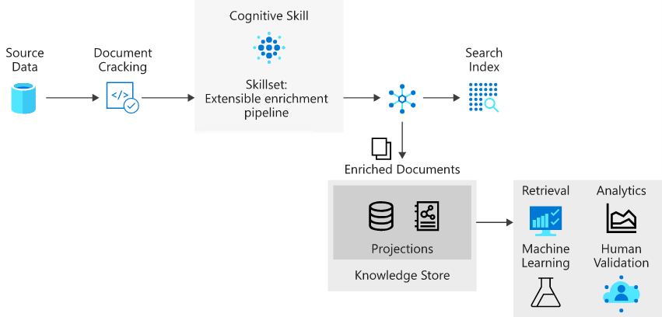
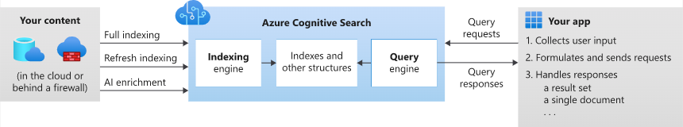
Azure Applied AI Services – Azure Cognitive Search
Key Features
Fully Managed
AI Enrichment
Semantic Search
Robust Query Syntax
Notes:
This is the end-to-end process for Azure Cognitive Search. The pipeline starts with your data source and ends with an enriched Index. The index is searchable via a flexible search syntax.
TOOK ABOUT AN HOUR TO GET HERE

Slide 27
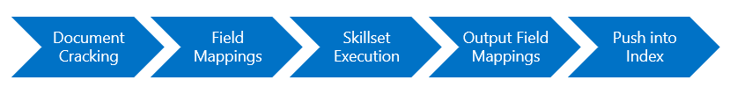
Azure Applied AI Services – Azure Cognitive Search
Stages of Indexing
Document Cracking
Field Mappings
Skillset Execution
Output Field Mapping
Push Into Index
Notes:
Indexer overview - Azure Cognitive Search | Microsoft Docs
https://docs.microsoft.com/en-us/azure/search/search-indexer-overview#stages-of-indexing
Document Cracking
Document cracking is the process of opening files and extracting content. Text-based content can be extracted from files on a service, rows in a table, or items in container or collection
Field Mapping
An indexer extracts text from a source field and sends it to a destination field in an index or knowledge store. When field names and data types coincide, the path is clear. However, you might want different names or types in the output, in which case you need to tell the indexer how to map the field.
Skillset Execution
Skillset execution is an optional step that invokes built-in or custom AI processing. You might need it for optical character recognition (OCR) in the form of image analysis if the source data is a binary image, or you might need text translation if content is in different languages.
Output Field Mapping
If you include a skillset, you will need to specify output field mappings in the indexer definition. The output of a skillset is manifested internally as a tree structure referred to as an enriched document. Output field mappings allow you to select which parts of this tree to map into fields in your index.
Push Into Index
Push the content to the index or Knowledge Store

Slide 28
Azure Applied AI Services – Azure Cognitive Search
Key Terminology
Index
Your searchable content available to the search engine
Indexer
Automate data import from supported data sources
Knowledge Store
A data sink from the enrichment pipeline
Skillsets
A set of AI Enrichments
Data Source
Sources for your Index
A table in general terms.
Notes:
There are several key terms to understand before we step into the demo.
Indexes are your searchable content available to the search engine.
Data Sources are just that
Indexers are components that provide the link between the Data source and Index. They allow for AI enrichments via Skills and handle the enrichment pipeline.
Knowledge Stores are a sink from the enrichment pipeline allowing for additional process of the enriched content. Use cases include running advance machine learning against the store.
Last is our Skillsets. These are custom or built in AI enrichments. For example, OCR, Named Entity Recognition and Form Recognizer are skills that can be added to further enrich a document. You could for example use a built in ID document model in Form Recognizer to extract Key / Values which are then attached as metadata for the ID document in the index allowing for rich filtering

Slide 29
Objectives
Connect to cognitive search
Build search interface to visualize the documents
Acceptance criteria
User Interface/Dev
Documents are available in near real time on the dashboard

Slide 30
Objectives
Test end to end project with document upload process
Acceptance criteria
End to End Acceptance
Processing the data and visualizing in the web tool

